Slide 1
Yet Another Microservices Solution (Yams)
Microsoft Studios (BigPark)
Nehme Bilal

Slide 2
Outline
Overview
Deployment process
Characteristics & Features
Demo

Slide 3
Overview
Yams is a deployment and hosting solution.
It can be used in Azure, other cloud platforms or on premises.
Applications are hosted as simple windows processes.
Features:
Fast deployments,
Sharing infrastructure,
Any programming language,
Upgrade domain support

Slide 4
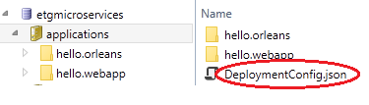

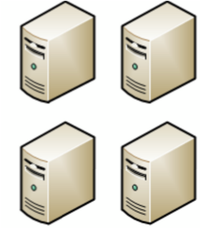
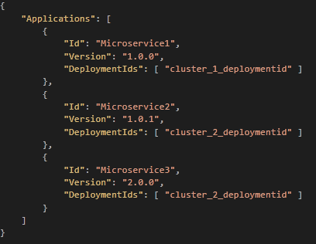

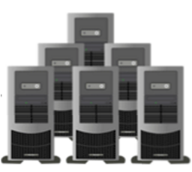
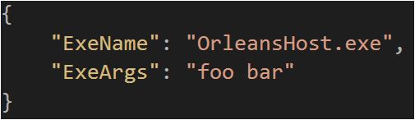
Deployment process
Deployment storage
Yams
Yams
Yams
Yams
Yams
Yams
Yams
Yams
Yams
Yams

Slide 5
Quick deployments
Deployment storage
When Yams detects a change in the DeploymentConfig.json,
it installs/uninstalls the relevant applications
Deployment time = download time + exe launch time

Slide 6
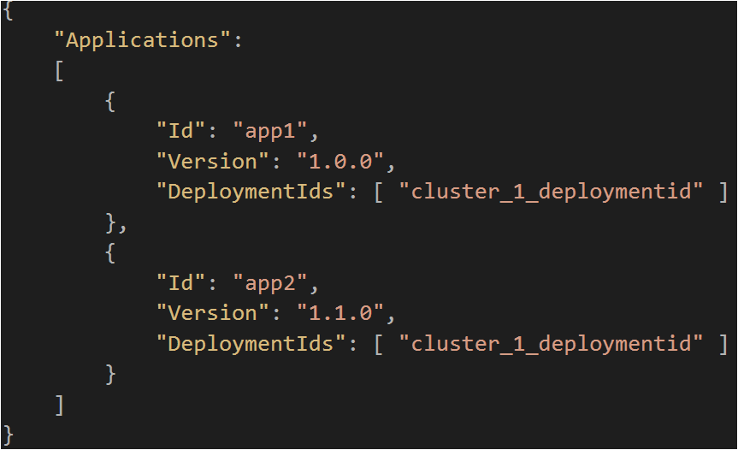
Sharing infrastructure
app1
app2
app1
app2
app1
app2
app1
app2

Slide 7
Support for upgrade domains
Yams ensures that the same application is never updated on different upgrade domains simultaneously.
1
1
2
2
3
3
1
1
2
2
3
3
TODO: Take VM out of load balancer during updates
Yams need to know when the application is ready to receive requests

Slide 8
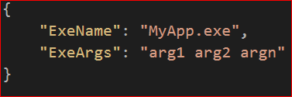
Any programming language
Yams can run any application that can be started with an exe.
AppConfig.json:
Example (OrleansHost):
OrleansHost.exe SiloHostName ConfigFileName deploymentId="DEPLOYMENT_ID“

Slide 9
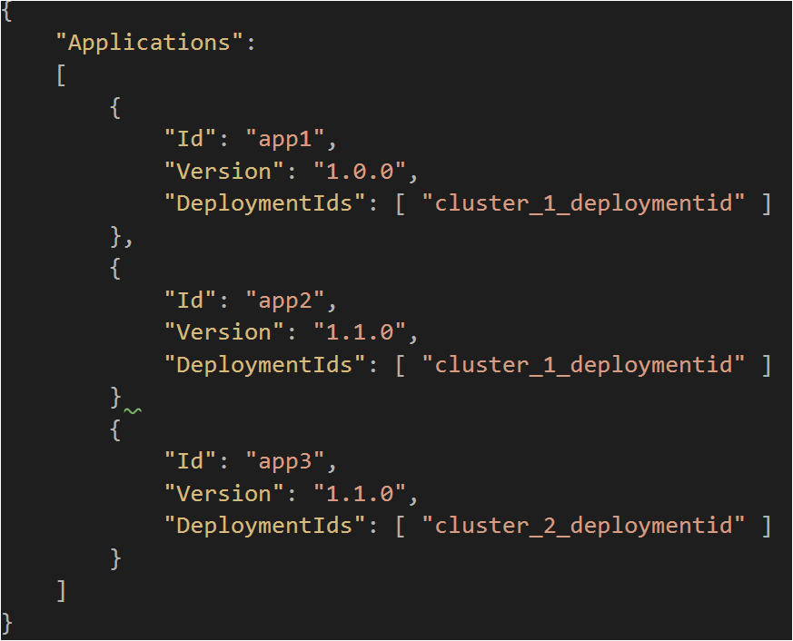
Scaling applications independently
app1
app2
app1
app2
app1
app2
app1
app2
app3
app3
app3
app3
app3
app3

Slide 10
Pluggable Architecture
https://github.com/Microsoft/Yams/blob/master/src/Etg.Yams.Core/YamsDiModule.cs
https://github.com/Microsoft/Yams/blob/master/test/Etg.Yams.Core.Test/EndToEndTest.cs

Slide 11
Summary
Fast deployments
Sharing infrastructure
Support for Upgrade Domains
Any programming language
Scaling apps independently
Pluggable Architecture

Slide 12
What’s next?
Join .Net Foundation
.Net Core support
VM scalesets template
Make Yams Observable

Slide 13
Deploy Orleans app demo

Slide 14
Questions?
Deployment storage
Yams
Yams
Yams
Yams
Yams
Yams
Yams
Yams
Yams
Yams

